Slide 1
Academic Writing for Social Good
Janet Salmons, Ph.D.
Research Community Manager, SAGE Methodspace

Slide 2
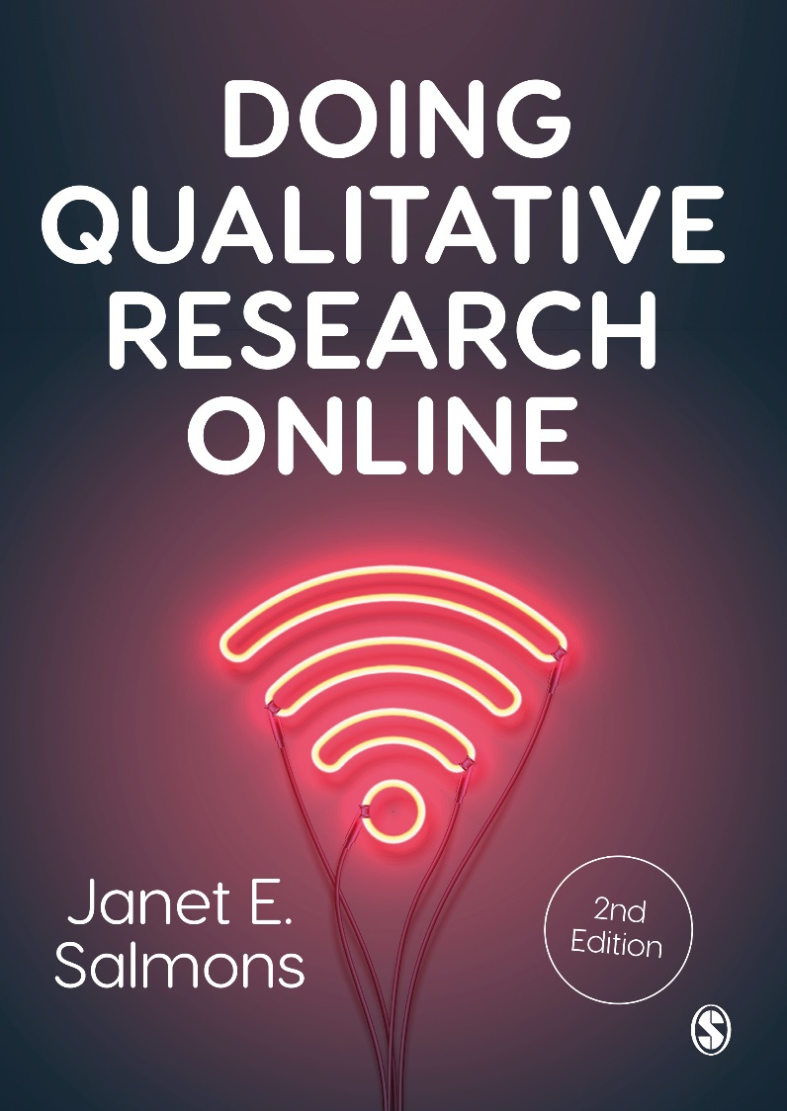
Research Methods Community Manager for SAGE Methodspace
Author of Doing Qualitative Research Online

Slide 3
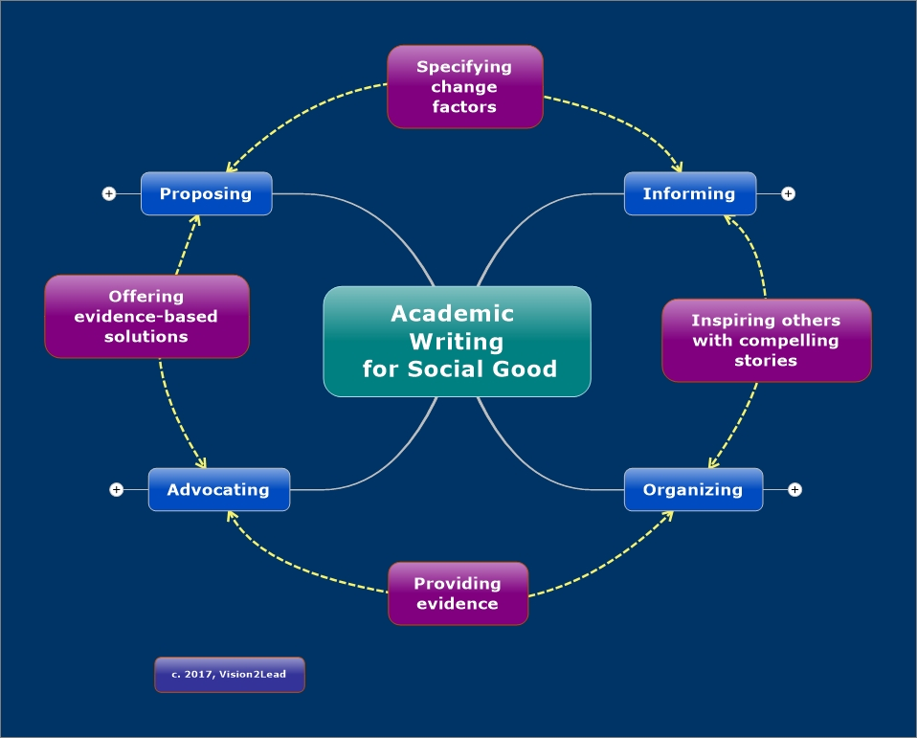
You can do good and do well!

Slide 4

Key Terms
Academic Writing
Social good
Writing that is grounded in empirical research and theory for audiences that include scholars, students, as well policy-makers, organizational leaders, and the public.
Writing that supports change to improve well-being of people in our communities or around the world.

Slide 5
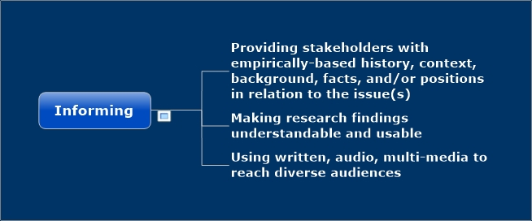
Use academic writing to inform
Who is your target audience and how can you reach them?

Slide 6
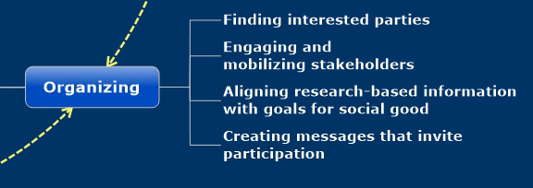
Use academic writing to organize
Who do you need to bring together to get things done?

Slide 7
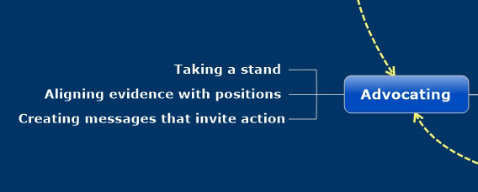
Use academic writing to advocate
How can you use research findings to advocate for change?

Slide 8
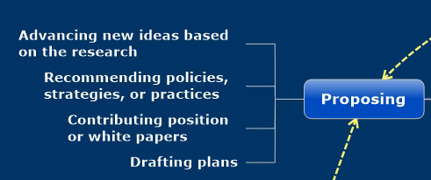
Use academic writing to support new directions
How can you use research findings to validate specific proposals?

Slide 9
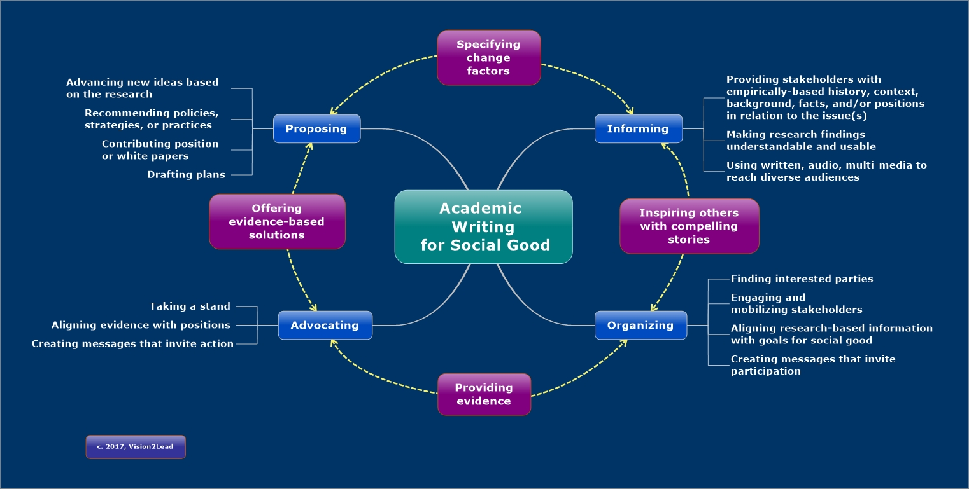

Slide 10
Types of academic writing
Articles
Blogs
Books

Slide 11
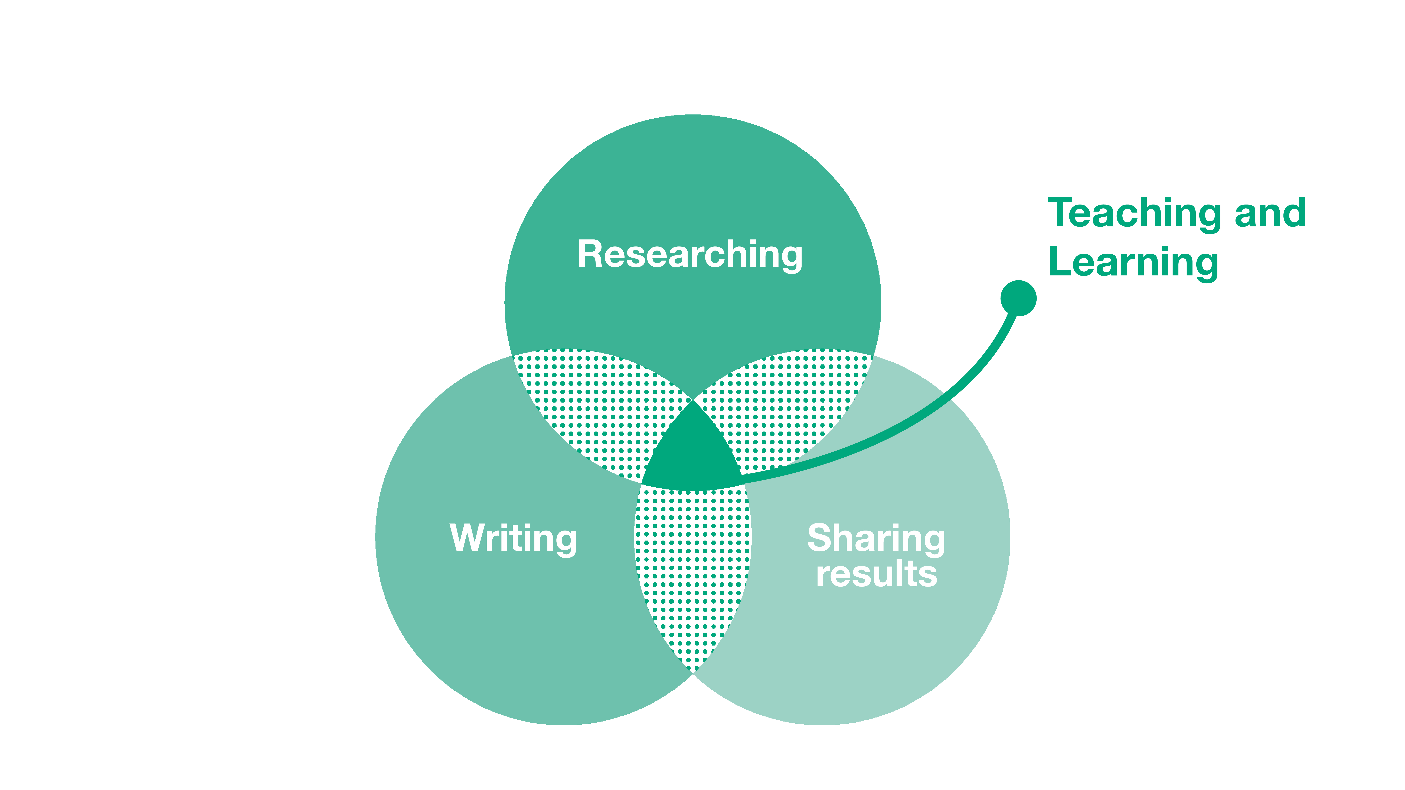
About Methodspace

Slide 12

Writing for Methodspace
Friendly tone
Personal style, can be first person
Tell the research story
Useful to global readers who are in a wide range of academic, government or agency, or independent roles.

Slide 13

Q & A

Slide 14

Independence with impact

